Slide 1
Station or not
Kevin Naik

Slide 2
Problem Statement
Station is sharing live data in terms of geospatial
Number of bicycles available in station
Data analytics for which station to close.

Slide 3
Constraints
Person has to go to dock
Requires internet
All systems are not available
Data is not live

Slide 4
Methodology
Foursquare API
SciKit-Learn
matplotlib and Folium

Slide 5
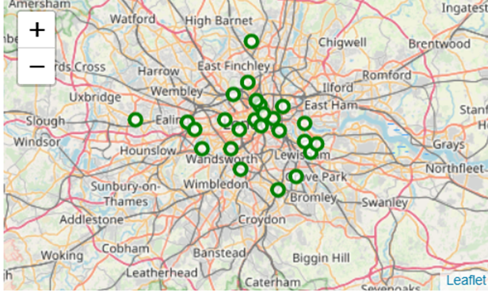
Results

Slide 6
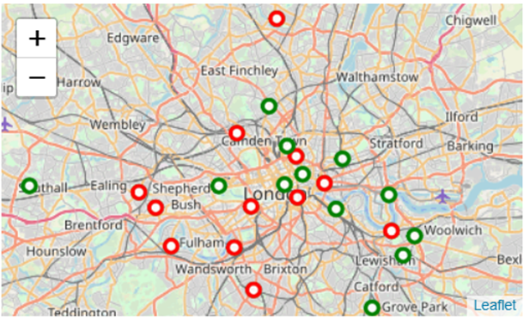

Slide 7
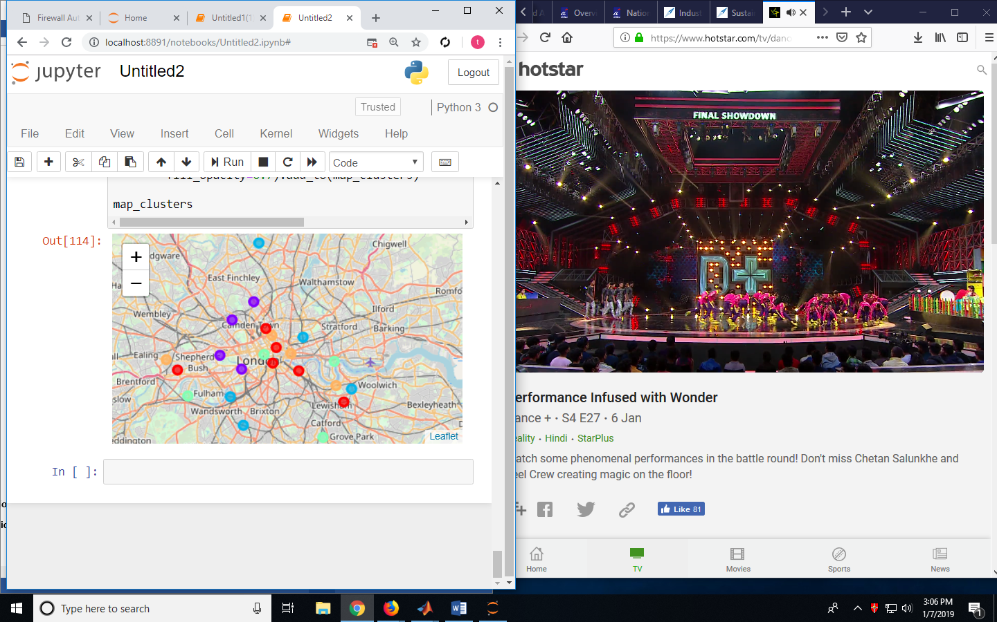

Slide 8
Conclusion
Greenwich, Acton, Aldgate, Angel, Arnos Grove, Balham, Barnes, Battersea, Bedford Park, Belgravia, Belsize Park and Blackfriars are station which can be shut if required.
Red clusters can be still kept open and reduced cycles from 10 to 5 for optimizing.

